Slide 1
APDC: An accessible, open-source package for smart automation of single-cell fluorescence microscopy experiments
Dmitri Svetlov ¹, Jack Forman ¹, Eric Ron ¹, Tatsuya Morisaki ², Tim Stasevich ^{1,2},
Brian Munsky ^{1,3}
¹ School of Biomedical Engineering, ² Department of Biochemistry and Molecular Biology, and ³ Department of Chemical Engineering, Colorado State University
62nd IBSIS-RMBS
April 11, 2025

Slide 2

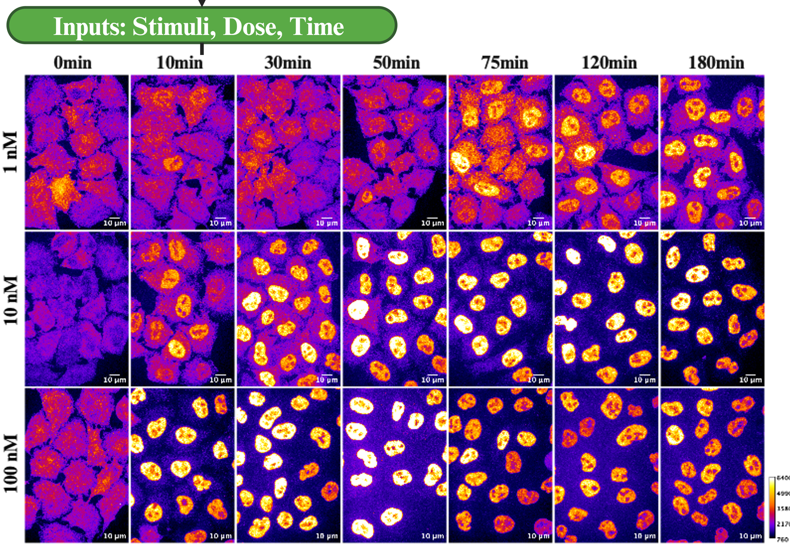
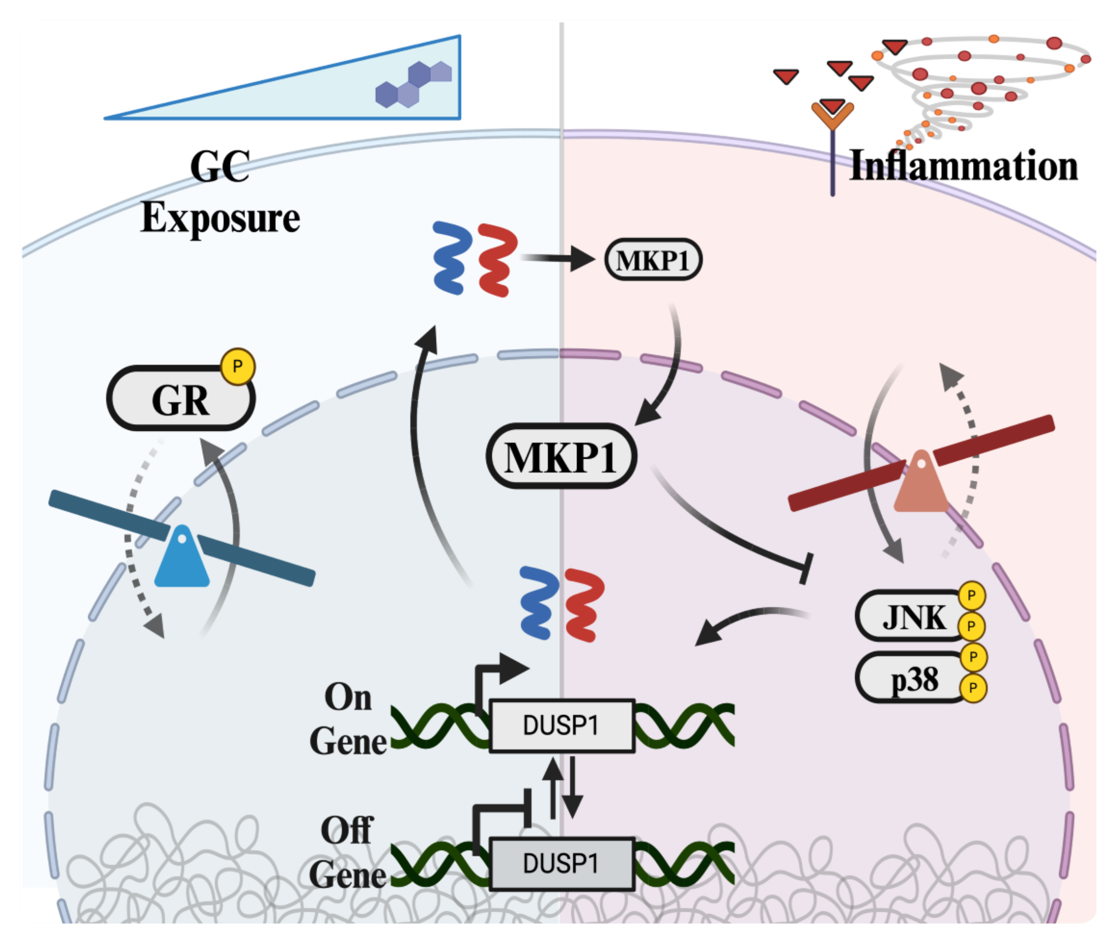
Motivating application: Effect of dexamethasone on DUSP1 expression dynamics

Slide 3
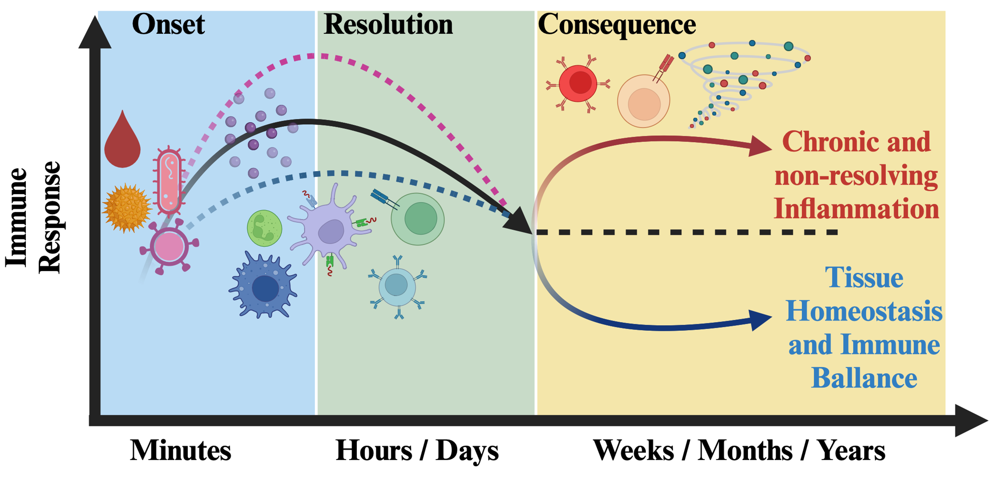
Why is predictive, quantitative understanding important?
Notes:
Under normal physiological conditions, inflammation is beneficial.
Following tissue damage or infection, innate and adaptive immune cells rapidly respond, guided by chemokine gradients to clear pathogens and facilitate tissue remodeling.
Pathological conditions arise when there's an overactive immune response, marked by elevated inflammatory cytokines like IL-1β and TNF-α.
Steroidal intervention with glucocorticoids (GCs) is commonly used to manage both acute and chronic inflammatory conditions.

Slide 4
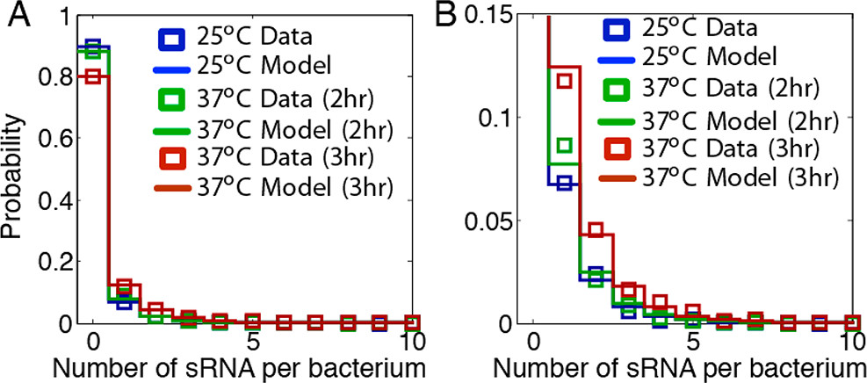
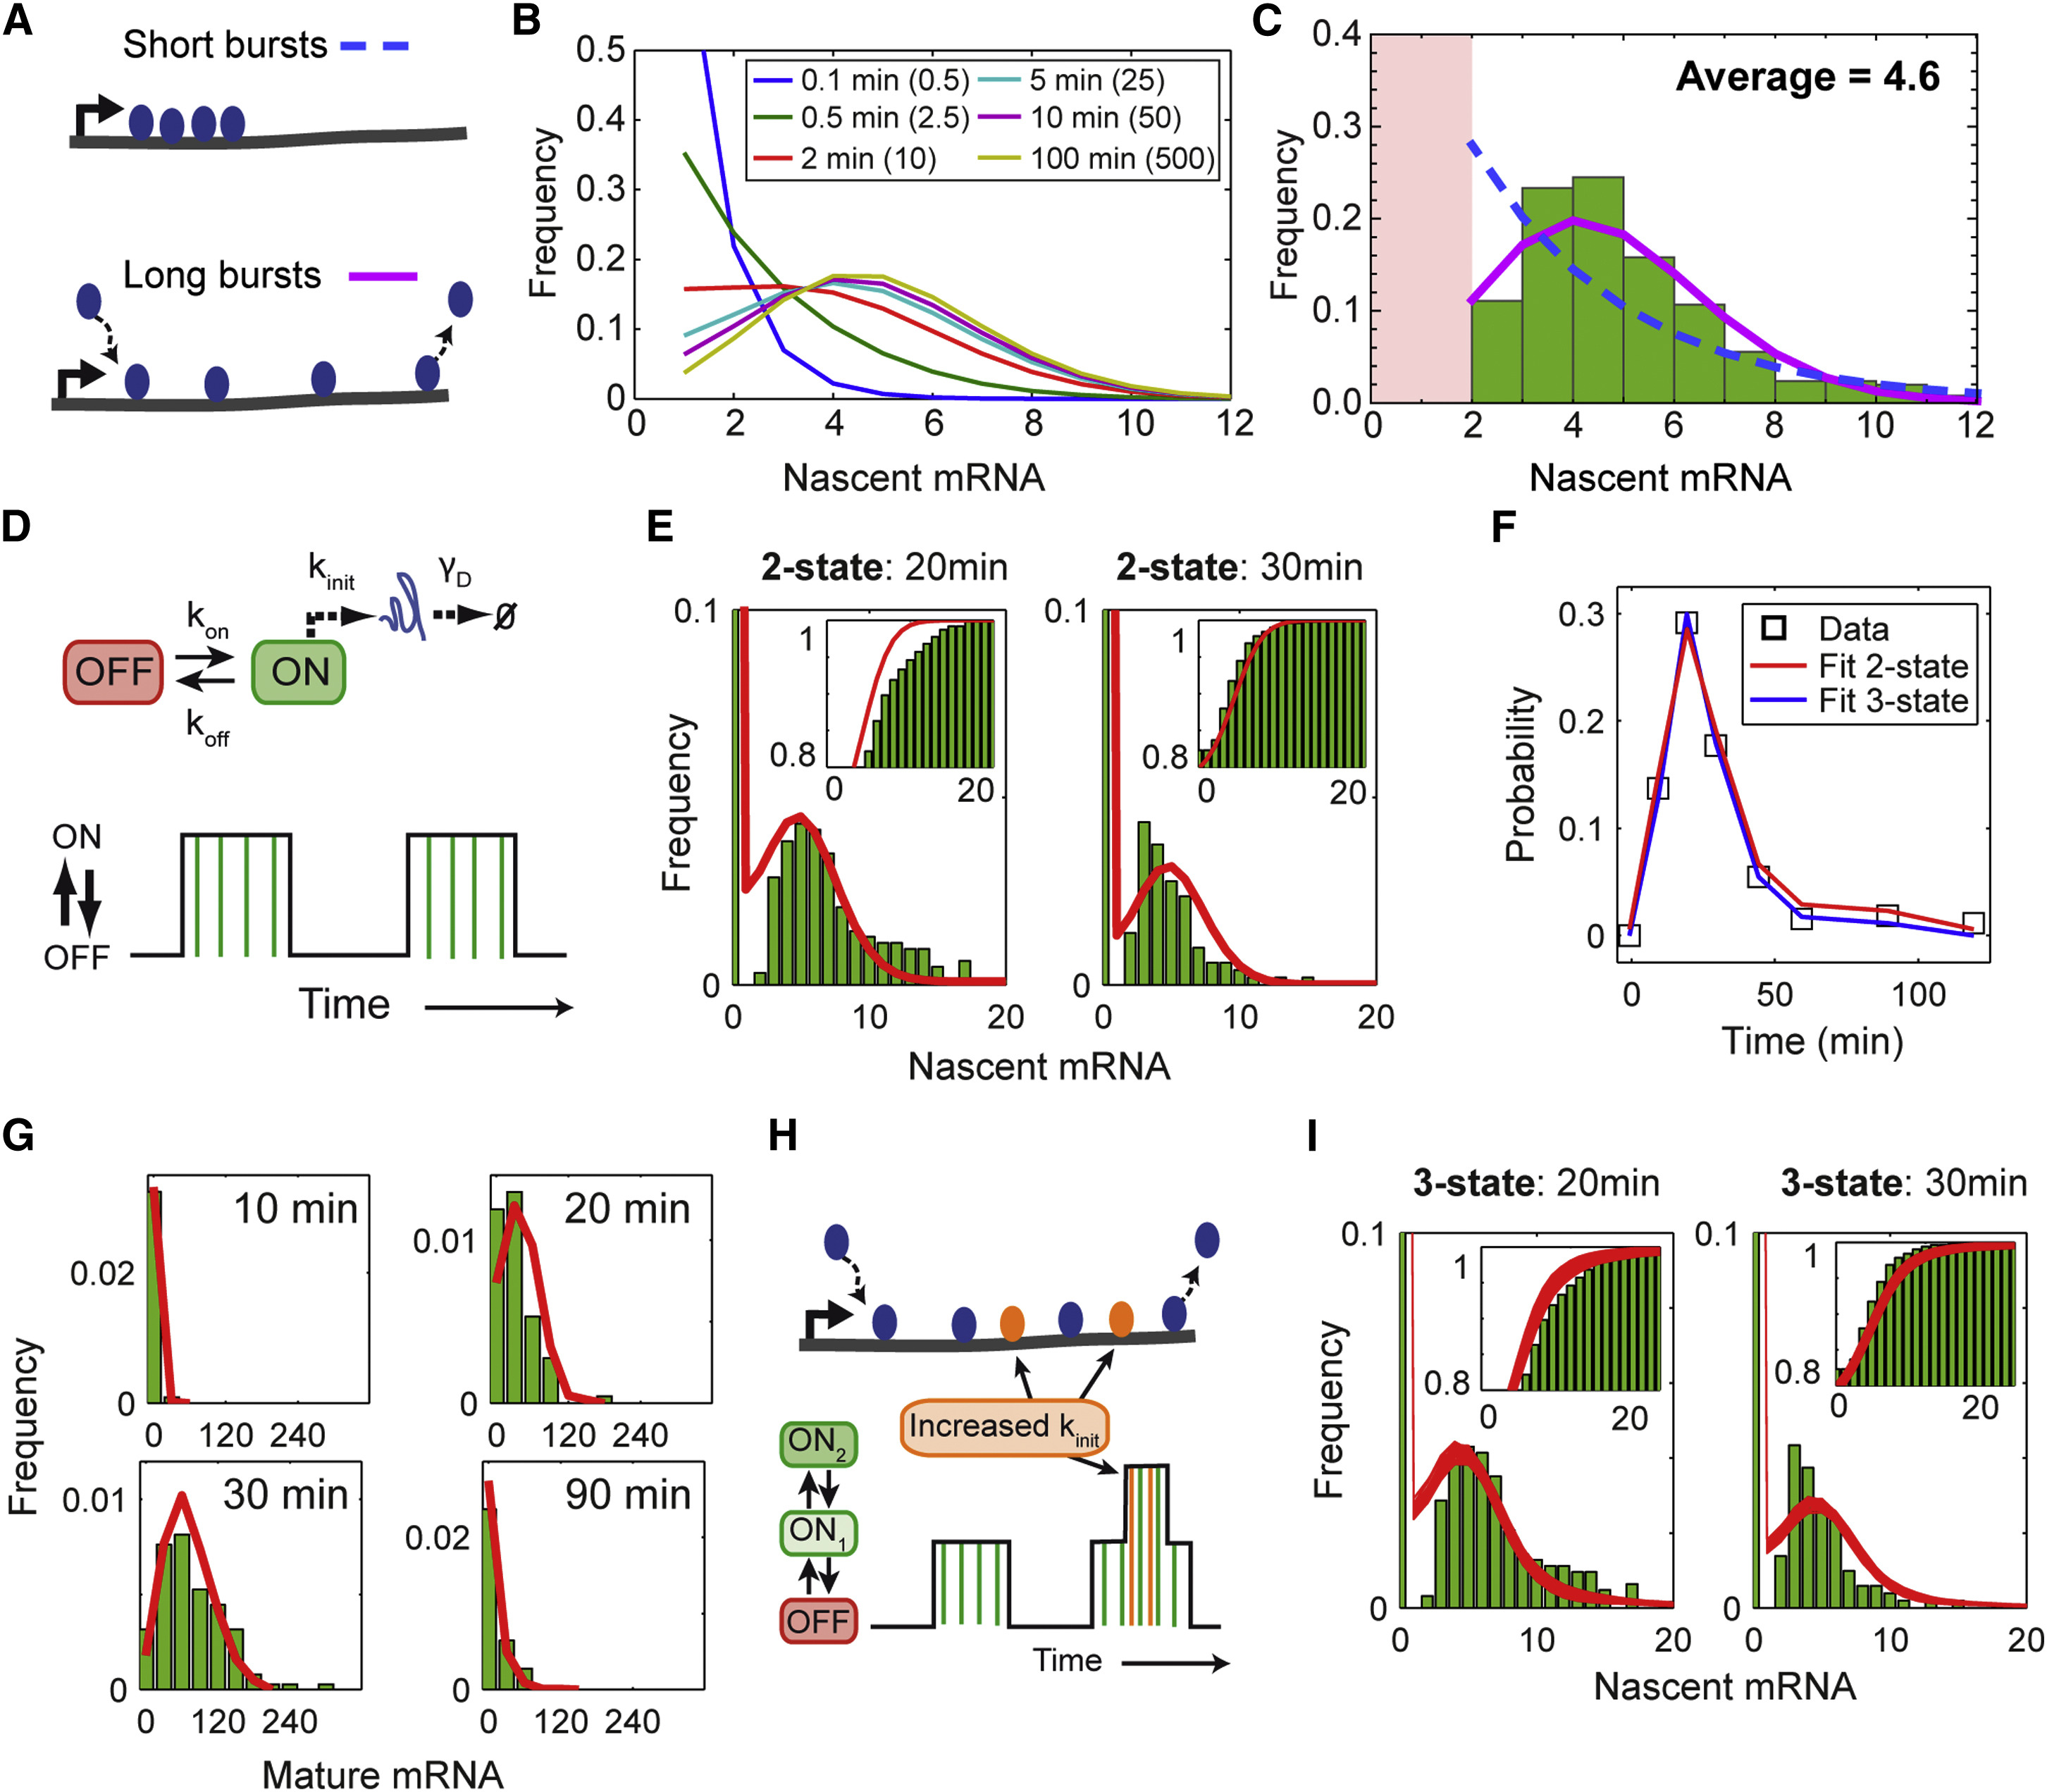
Modeling gene expression is possible, despite stochasticity and heterogeneity…
Shepherd et al. Analytical Chemistry 85 (2013)
across:
Phyla
Model complexities
Experimental challenges
Senecal et al. Cell Reports 2017
Notes:
YSP8 sRNA in Yersinia pestis and Y. pseudotuberculosis is a short RNA that may be utilized in human infection.
c-Fos is an early response gene activated by various stimuli, e.g. serum induction and heavy-metal exposure; these two stimuli activate the MAPK pathway, and the phosphorylated kinases (ERK and p38 respectively) are the transcription factors.

Slide 5
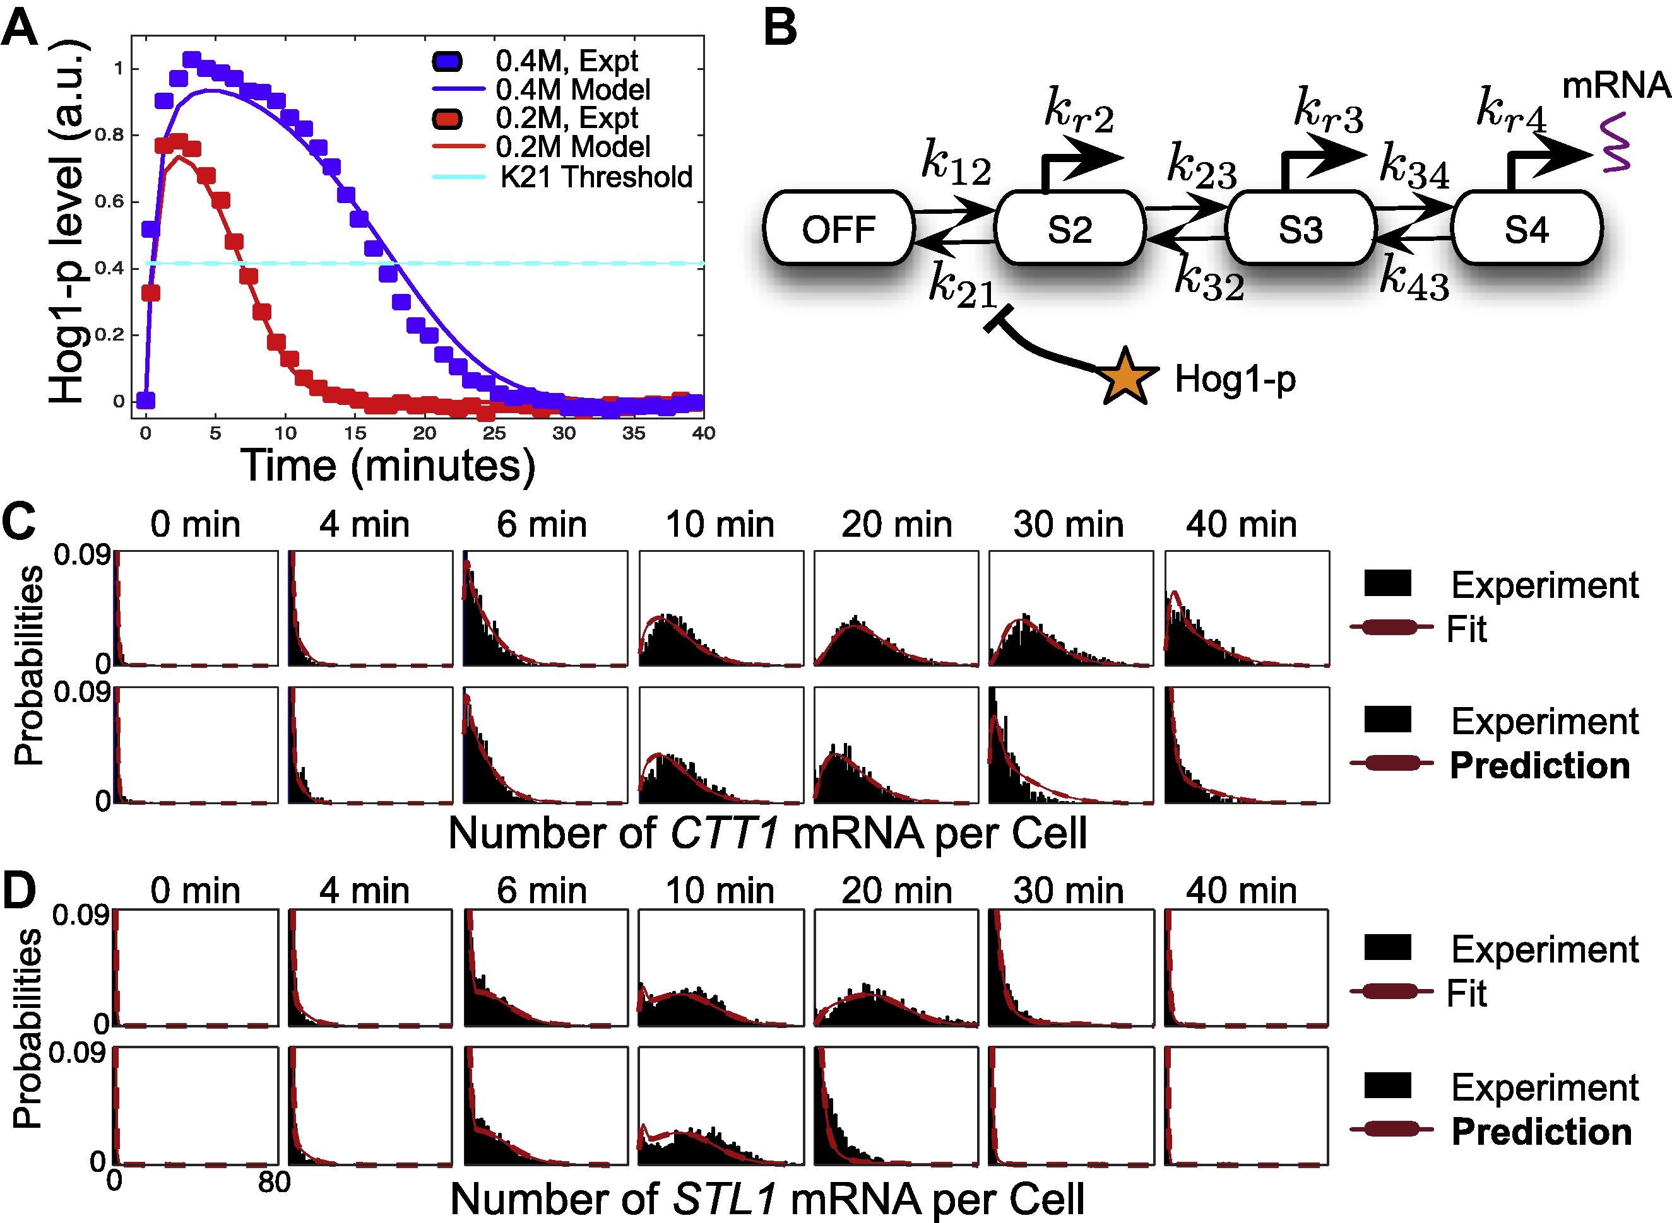
Figure: Munsky, Fox, Neuert Methods 85 (2015)
Data: Neuert et al. Science 339 (2013)
Notes:
S. cerevisiae STL1 is upregulated by the Hog1p (high-osmolarity glycerol) kinase, which is in the MAPK pathway; its activation is part of the yeast’s response to osmotic shock.
Each paper took over two years and involved multiple collaborators!

Slide 6
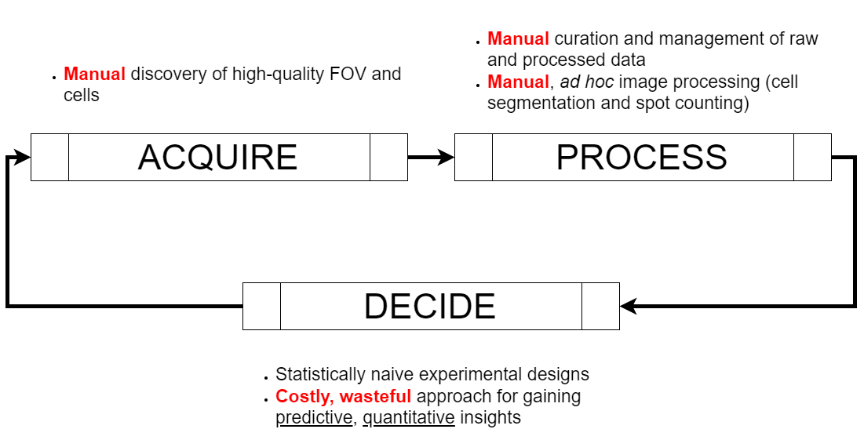
What’s taken you so long?!?
Notes:
Slow, human-intensive experiments
Low consistency and reproducibility
low predictive, quantitative insight per experimenter time and money
The killer has been the time lag between acquisition and understanding.
Before now, people just did random/combinatorial titrations to explore fixation conditions, antibody doses, etc.
The acquire step took 6 months, the processing step took 6 months…
An entire cycle of FISH experiments can take a year; many graduate students will only do a few such cycles during their Ph.D. work.

Slide 7
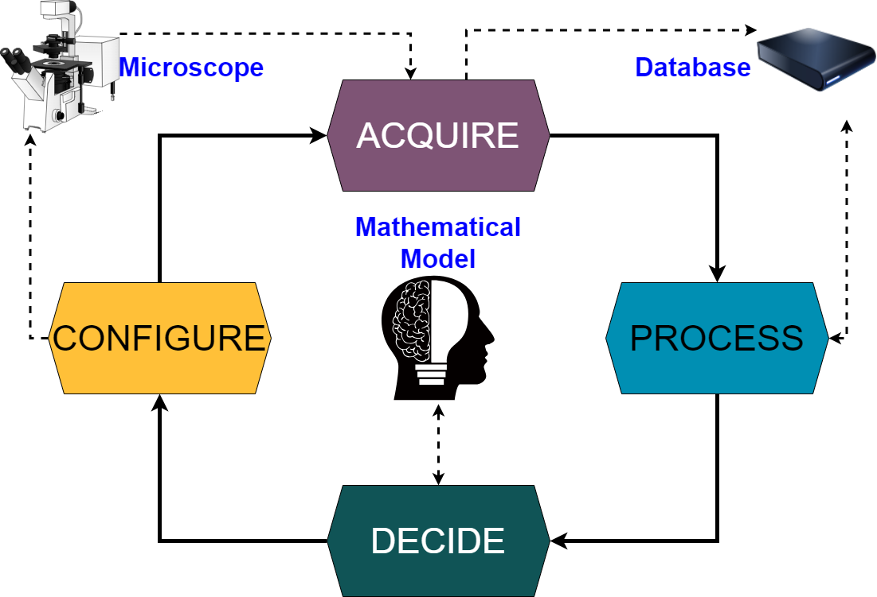

Slide 8
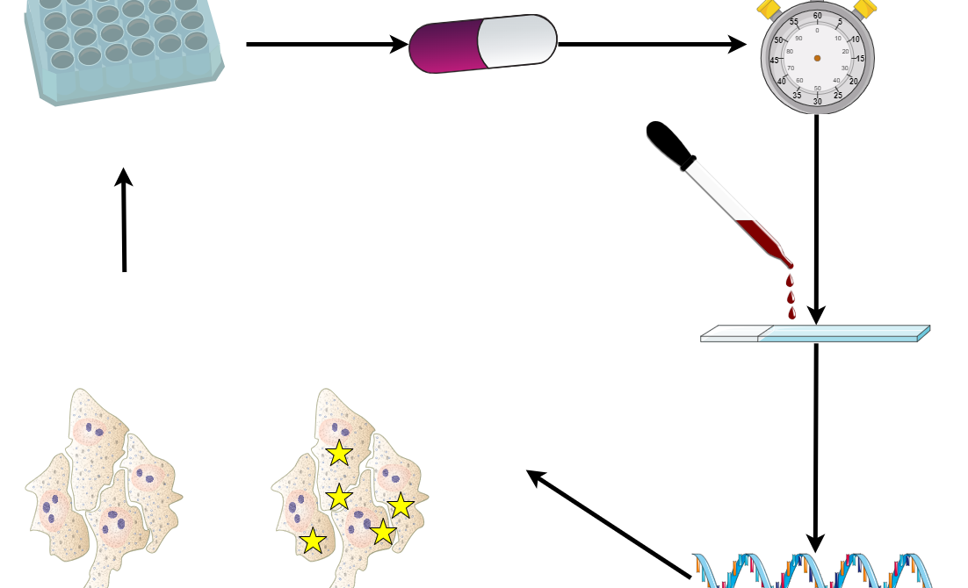
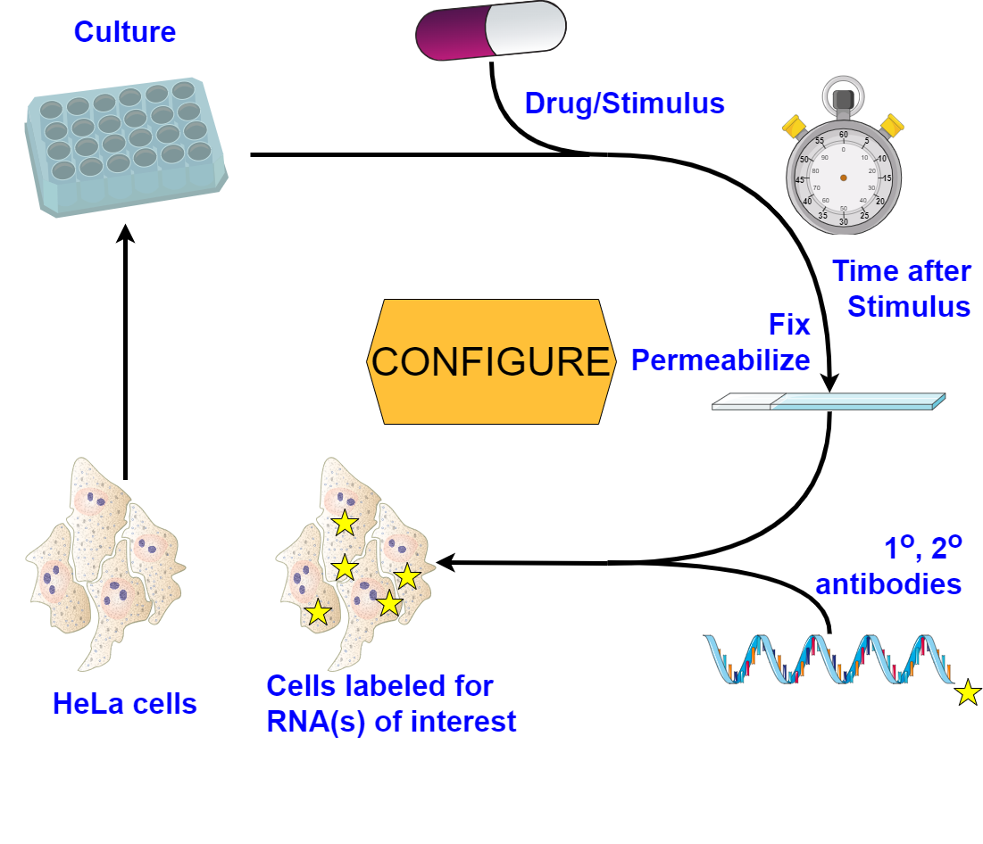


Slide 9
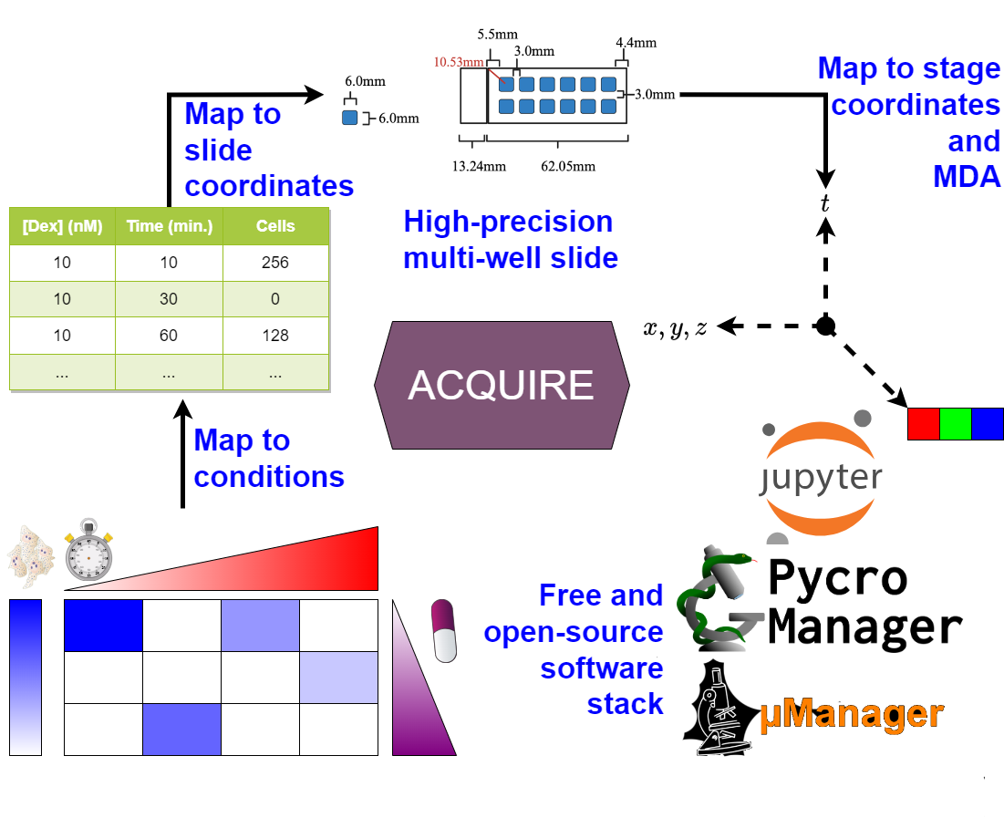
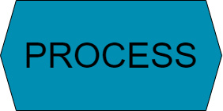
Notes:
Before automation, it took an imaging session of >12 hours to obtain 3000 cells at each of 12 conditions – all that time was hands-on. About 30 useful FOV per slide, with about 10 cells per FOV; these FOV had to be found by hand.

Slide 10
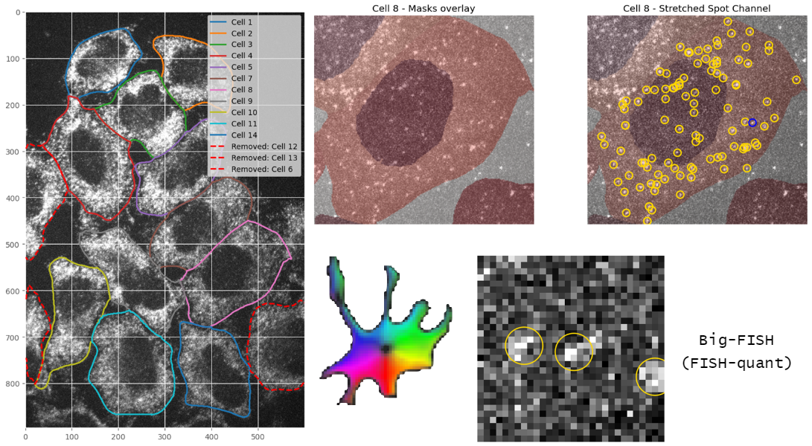
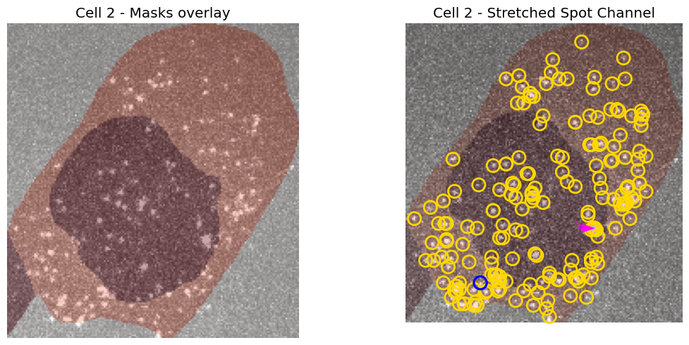

Stringer et al. Nature Methods 18 (2021)
Imbert et al. RNA 28 (2022)

Slide 11
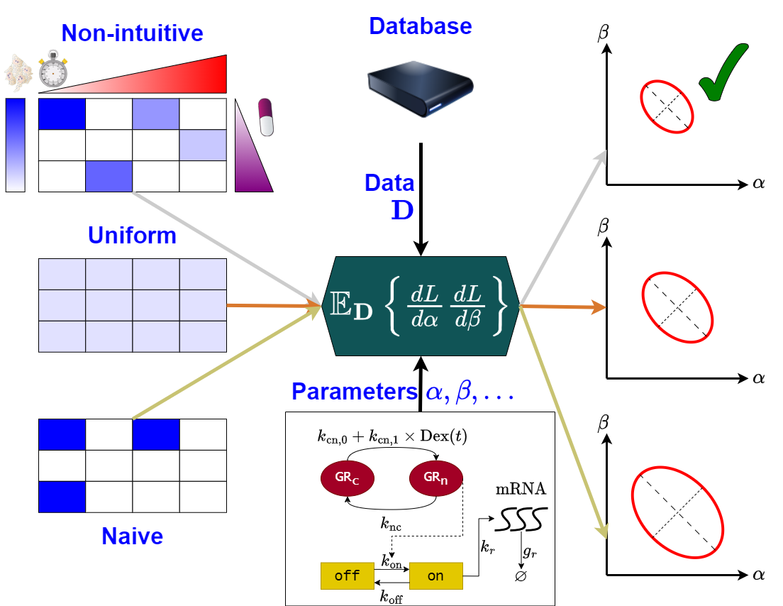


Slide 12
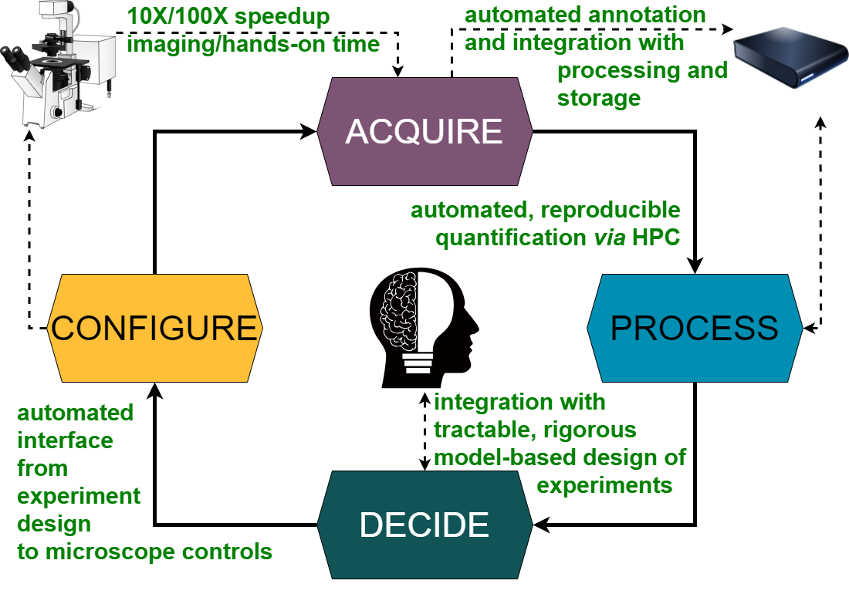

Slide 13





Munsky Group Dr. Luis Aguilera de Lira * Emika Buschow Joshua Cook * Alex David Dr. Linda Forero Quintero * Jack Forman Dr. Zachary Fox * Isabelle Lemma Dr. Michael May * Dr. Brian Munsky Dr. Alex Popinga Dr. Will Raymond Eric Ron Sai Srikolupo Munsky Group Dmitri Svetlov Dr. Huy Vo * Collaborators Dr. Xavier Darzacq Dr. Tatsuya Morisaki Dr. Florian Mueller Dr. Gregor Neuert Dr. Tim Stasevich Dr. James Werner (* denotes Munsky Group alumni)

